Slide 1



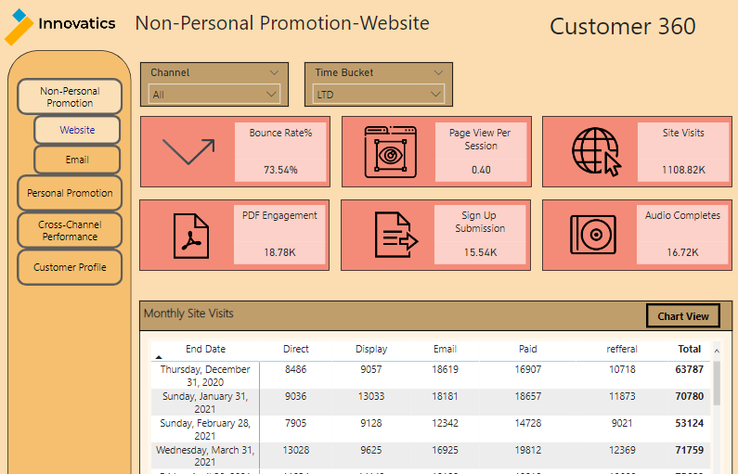
Customer 360 – Marketing Dashboard
Motive
Analytics Pipeline
Objective
This Dashboard Tracks performance for website and different marketing campaigns viz. email channel, speaker program and call activity. the dashboard also enable us to track Healthcare Professionals(HCPs) individual engagements
Our Solution
This performance tracking solution for each channel Dashboard which will help track product performance on multiple hierarchical levels and different campaign.
Gives the user a relatable information which campaign more effective and which need to carry-forward or need to change strategy.
Marketing Tools and Platforms
Data Transformation
Business Intelligence Tools
CRM platform is used to track visits completed by field employees.
Google Analytics is used to track Web marketing performance.
Data received from the different campaign which stored and used by Excel sheet here and SQL.
Monthly refresh planned for both dashboards (Field and HQ).
Track geography, Segment and individual HCPs end .
Dashboard Sample and Use Case
Dashboard
Benefits
Different Channel Performance Tracking and compare each channel performance parallel.
Analysis at multiple granularities: Accounts, Segments, Geography.
Management can check Geography wise Budget Allocation.
Ad-Hoc Reports for daily tracking and actions.
We can connect with more HCPs by there affiliation centers.
This dashboard shows a portion of what information can be viewed by employees at the HQ.
The use case shown here is for the performance of the products across the different Geographies. CRM data is presented here to show KPIs like Email sent, Email Open, Email Click, Click through rate, open rate , Opt out rate, HCP reached by email , HCP engaged by email from field employees etc.
.All KPI track by Different Time bucket and check performance and comparison in time bucket
* Estimated

